Slide 1
FIG Enterprise Data Management
Target State Architecture
June 25

Slide 2
Focus Of the Hour
Background: XXX and TCS’ discussions so far
01
TCS’ vision for XXX’s Enterprise Data Platform
02
Solution Overview
03
High level architecture & key solution tenets
04

Slide 3
Focus Of the Hour
Background: XXX and TCS’ discussions so far
01
TCS’ vision for XXX’s Enterprise Data Platform
02
Solution Overview
03
High level architecture & key solution tenets
04

Slide 4
Enterprise Data Management Philosophy
INTEGRATE | GOVERN | OPTIMIZE

Slide 5
Key Understanding
Strategic
Operational Efficiency
Cost
Shape Integrated & Governed Data Platform.
Lay foundations of Data-driven organization
Accelerate “speed to insight”
Augment Regulatory Reporting with Compliance
Build Future Proof Data Lake & Analytics Landscape
Cloud-First Strategy followed by optimization using AWS services
Align with XXX’s architecture & governance Policies
Enable effective Data Quality, Data Catalog, Audit trail
Handle Unstructured Data and Near Real Time Feeds
Effortless Data Platform elasticity
Improve Agility
Aligns with the latest industry principles.
SaaS over PaaS over IaaS
Embrace Simplified landscape
Minimize Total cost of Ownership
Minimize the licensing cost
Minimize operational maintenance cost
Leverage Transient mode of services
Embrace ‘Pay what you use’ model
XXX’s Priorities
(TCS’s Understanding)
Key considerations
(For solution approach)

Slide 6
Focus Of the Hour
Background: XXX and TCS’ discussions so far
01
TCS’ vision for XXX’s Enterprise Data Platform
02
Solution Overview
03
High level architecture & key solution tenets
04

Slide 7




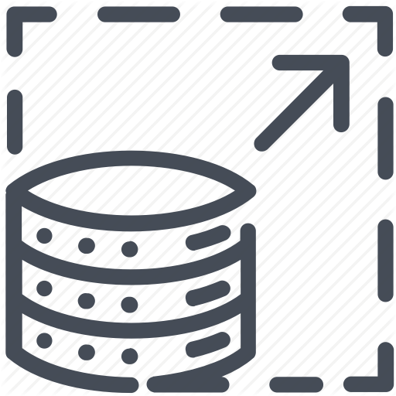

Attributes to Design – XXX Data Management Solution
Dive Anywhere, Flexible access, Schema-on-read – Diverse toolset and processing types based on data & use case
All Data in one Place – a single source of truth for source data.
Quick Ingest Any data, don’t enforce schema-on-write.
Repository of Data to keep in RAW/Natural format
Low-Cost Scalable Storage, decoupled from compute & system process.
Future Proof.

Slide 8






Principles Of Data Architecture to be followed
Decoupled systems
Right tools for right job (Data Structure, Access Pattern)
Classifying Hot & Cold Ingestion channels
Leverage managed / serverless services
Event driven Design pattern (System Driven)
Cost consciousness

Slide 9
Focus Of the Hour
Background: XXX and TCS’ discussions so far
01
TCS’ vision for XXX’s Enterprise Data Platform
02
Solution Overview
03
High level architecture & key solution tenets
04

Slide 10
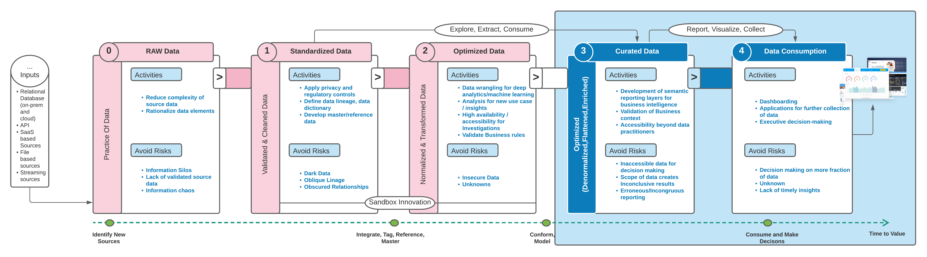
Data Architecture
1
Data is a business-driving asset, becomes center of decision making.
2
The wrangling of tons of data into a structure that enables intelligence usage — and the service of data — constructing a user interface that enables the consumption of data for decision making more effective.
3
Data as asset and data modeling both require a supportive engagement infrastructure that gets the right person access to the right data to make the right decision at the right time.
4
Over time, layered approach reduces redundancy, decreases dark data and increases return on investment earlier in data lifecycle.

Slide 11


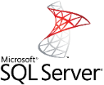
High Level Solution Data Flow Architecture
External Sources
6
Consumption
Salesforce
3
Analysis of Raw Data
AWS Sources
Enterprise Data Warehouse
Data Lake
Genesys
Copernicus
Payments
Landing/Raw
Layer
Tech
Standardized
Optimized
Layer
5
DW
7
Self Service Reports
Workday
Loss Trak
Captiva
1
Dashboards
4
Data Marts
On-prem Sources
Canned Reports
UNITY
Documentum
VMGA Files
2
Temenos
CU Financial
1
Data extracted from AWS Aurora Sources like Copernicus, Payments and MS SQL Sources on EC2 like LossTrak, UNITY are loaded to Landing layer of Data Lake
2
Data extracted from on-prem systems like Files from MVGA, CU Financial Data, etc.. and loaded to Landing layer of Data Lake
3
Data extracted from external systems like Salesforce, Workday and loaded to Landing layer of Data Lake
4
Data stored in different formats in landing layer will be standardized into technical and optimized layer layers
5
Data loaded from Optimized layer of Data Lake into the Data Warehouse. The Warehouse will be in Dimensional model and will contain conformed data
6
Data pulled from Data Lake by Analysts/ Data Scientists for analysis on raw data.
7
Reports and Dashboards are built on top of Data Warehouse tables for consumption by users

Slide 12
Systems in Target Data Lake and Data Warehouse
Source | Target
Salesforce | Data Lake, Data Warehouse
Workday | Data Lake, Data Warehouse
UCAP (Data Capture) | Data Lake, Data Warehouse
CoperniCUS | Data Lake, Data Warehouse
UNITY | Data Lake, Data Warehouse
LossDraft | Data Lake, Data Warehouse
Virtual MGA (Excecss Flood) | Data Lake, Data Warehouse
AMS (Insurance Partners) | Data Lake, Data Warehouse
Genesys | Data Lake, Data Warehouse
Collections | Data Lake, Data Warehouse
Client Data Files | Data Lake
3C Vendor Data | Data Lake
IDomoo | Data Lake
Google Analytics Data | Data Lake
Verisk Analytics | Data Lake (Future)
Payments | Data Lake (Future), Data Warehouse (Future)
Recovery One | Data Lake (Future), Data Warehouse (Future)

Slide 13
Focus Of the Hour
Background: XXX and TCS’ discussions so far
01
TCS’ vision for XXX’s Enterprise Data Platform
02
Solution Overview
03
High level architecture & key solution tenets
04

Slide 14
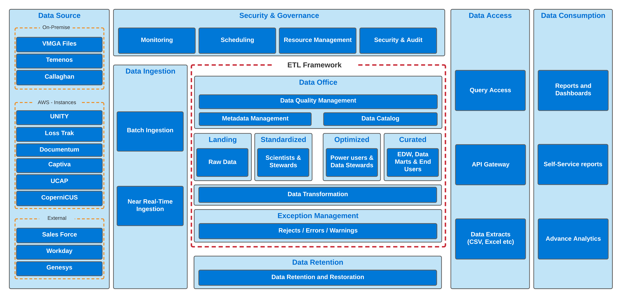
Functional Architecture

Slide 15
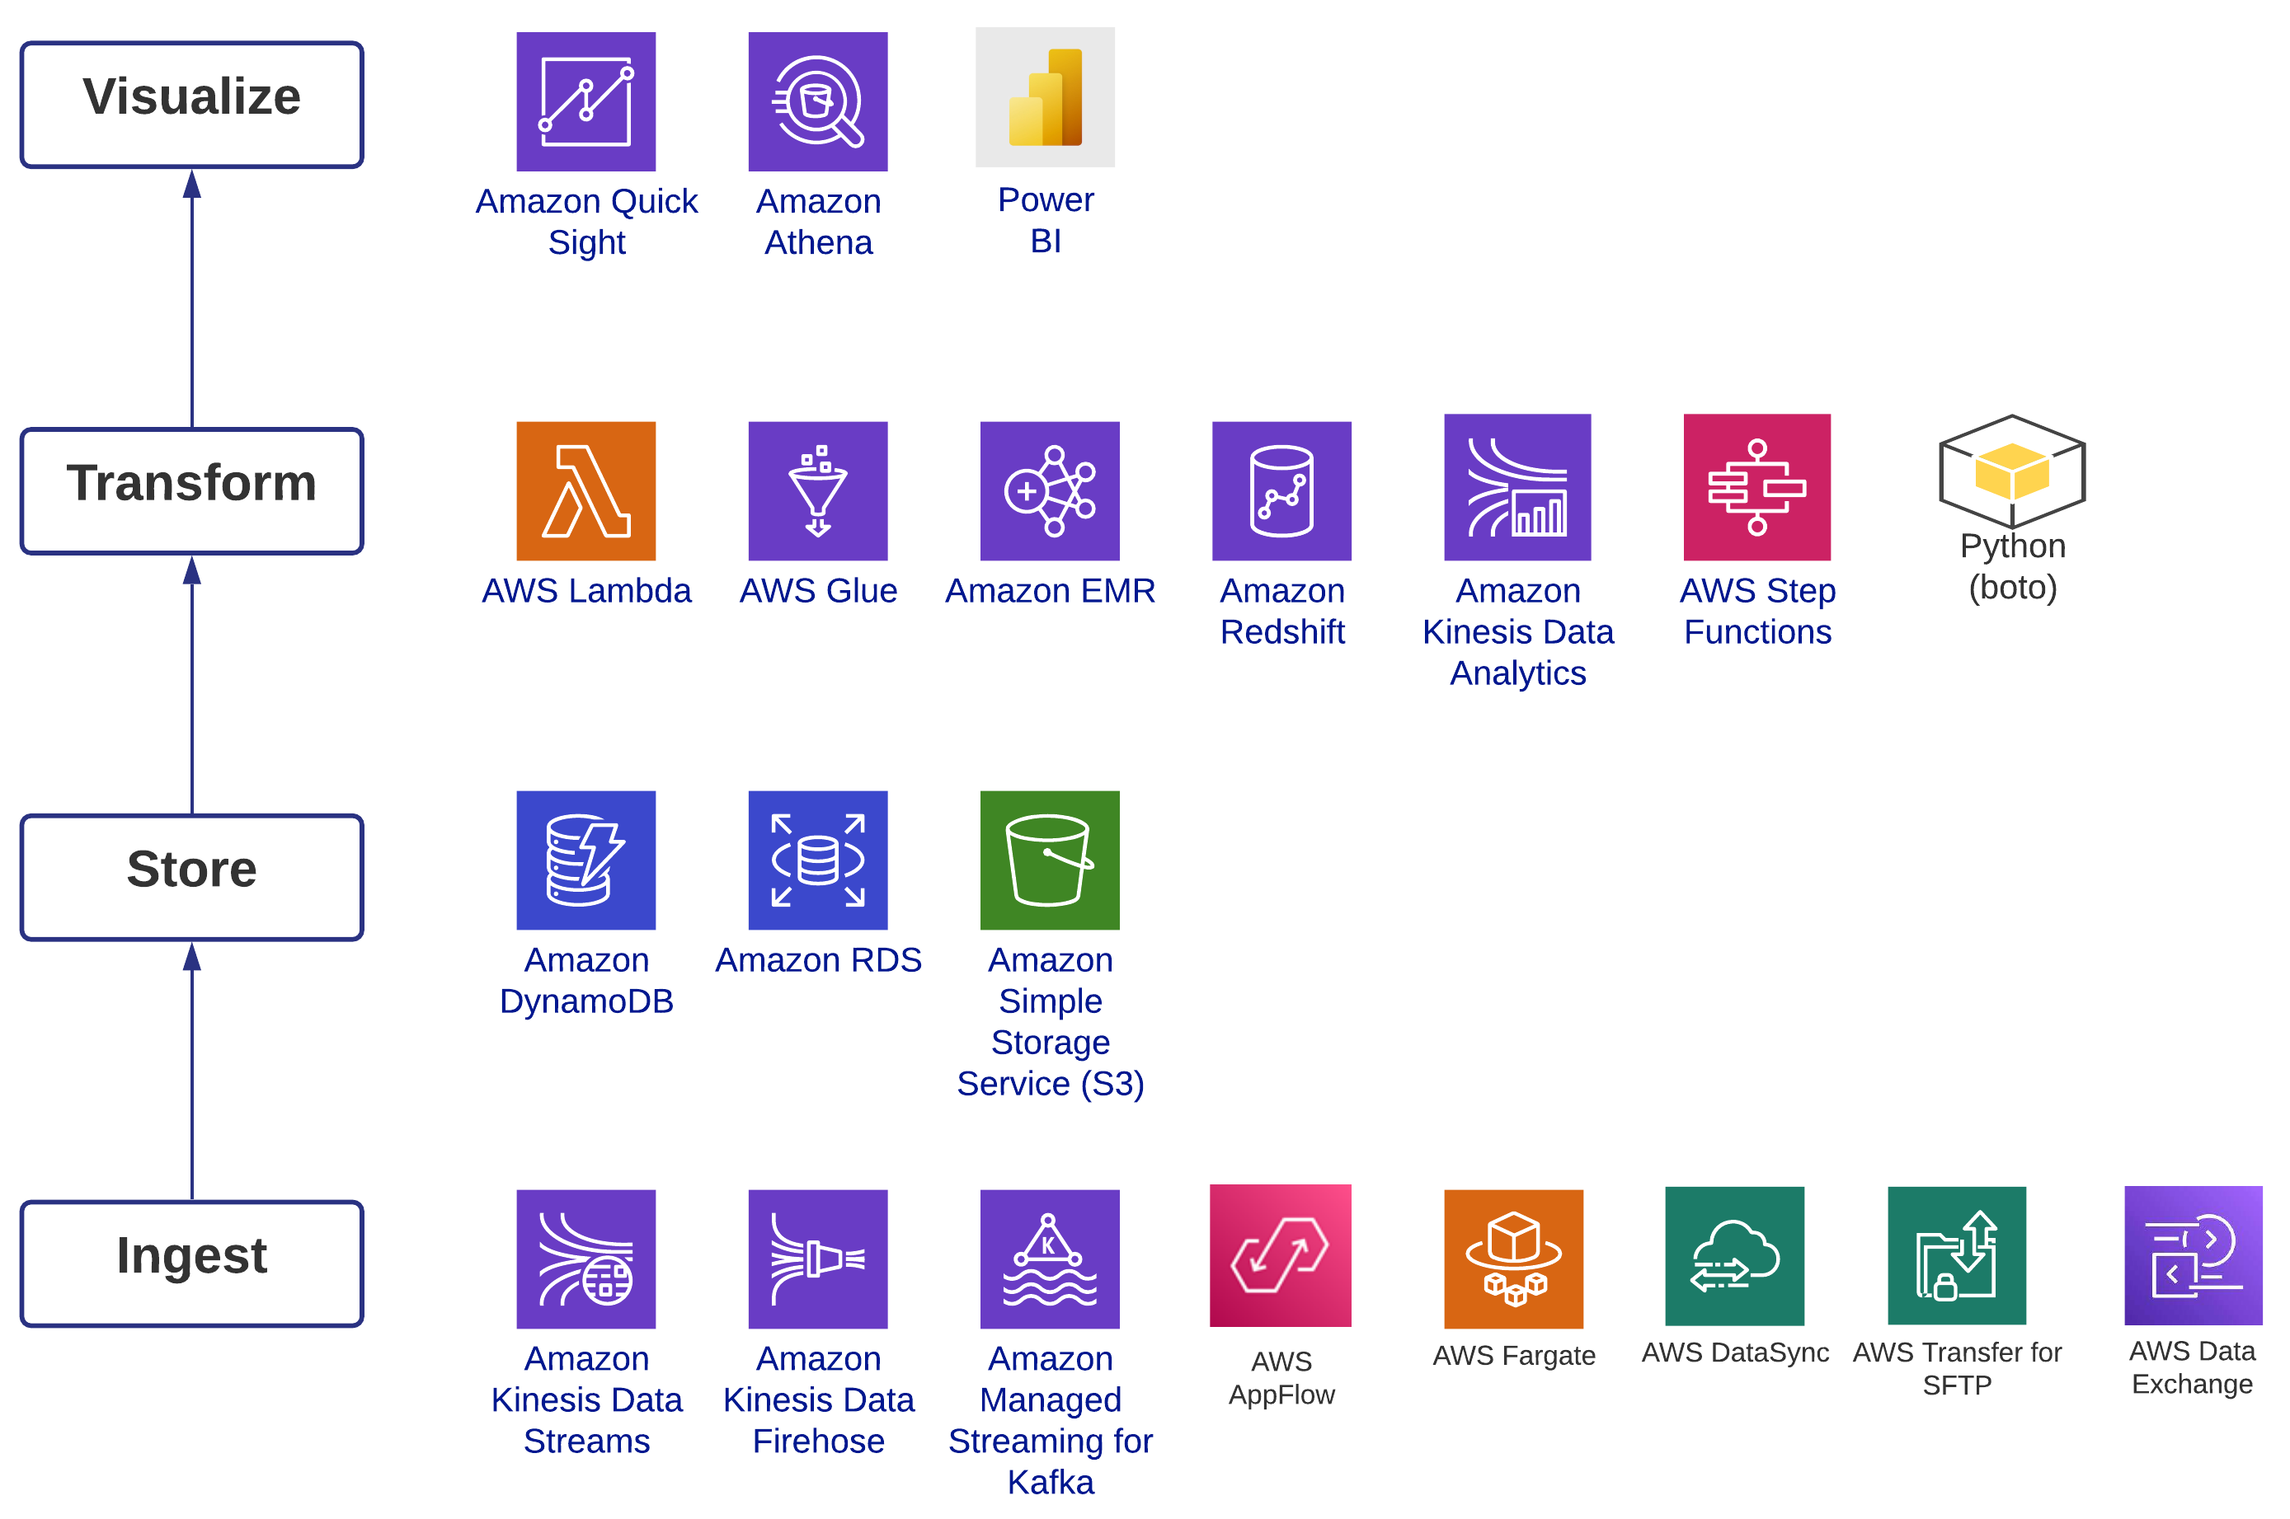
AWS Services – Architecture Solution Components

Slide 16
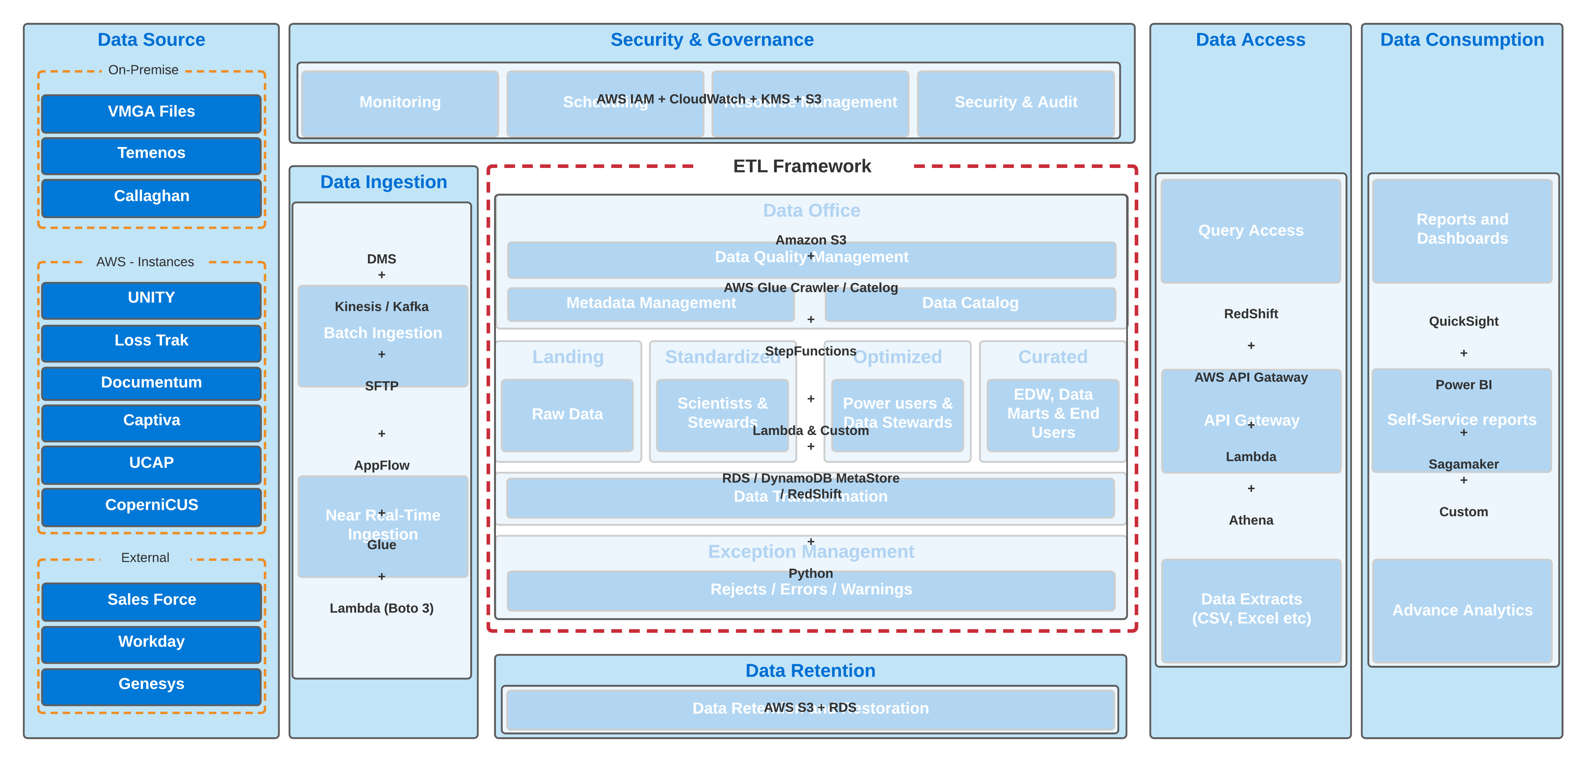
Functional Architecture mapped to AWS Services

Slide 17
Data Ingestion – Considerations
Ability to ingest multiple types of data with varying ingestion patterns are challenging, Requires in-depth analysis.
Historical Batch
Batch data ingestion imports data in discrete chunks at more pre-determined time slots by prioritizing data sources, and routing data items to landing zone for data migration purposes.
Incremental Batch
Ingesting data at consistent and reasonable speeds to the landing zone. The incremental batch data is usually a daily batch process but can be intra-day or weekly/monthly/quarterly/annual process as well.
Near real time
Data is sourced, loaded into the landing zone as soon as it is created or recognized by the data ingestion process. Some of the streaming data might be ingested by micro batching.
Historical Batch
Incremental Batch
Near Real Time
Data File Migration
Periodic incremental Batch File Load
Streaming Data
Database Migration
Time based incremental Data extracts
Event based data
Initial Data Load

Slide 18
Data Ingestion – Pipeline Classification
 | Historical Batch (Cold Path) | Incremental Ingestion (Hot Path) | Near Real-time (Warm Path)
 |  |  | Streaming Data Ingestion | Message Queue
Relational Database | DB Migration Service Data Transfer Services Data Sync | JDBC/ODBC Connectors Glue
File Sources | Storage Gateways Snowballs/Mobiles Data Sync SFTP | SFTP Storage Gateways
APIs | Glue SDKs | Glue Lambda SDKs AppFlow | Glue SDKs AppFlow
Streaming Sources |  |  | AWS Kinesis Direct Connect MSK
Documentum (ECM) |  | Glue Lambda SDKs |  | Rabbit MQ AWS Data Exchange Lambda
Captiva / UCAP | DB Migration Service Data Transfer Services Data Sync

Slide 19
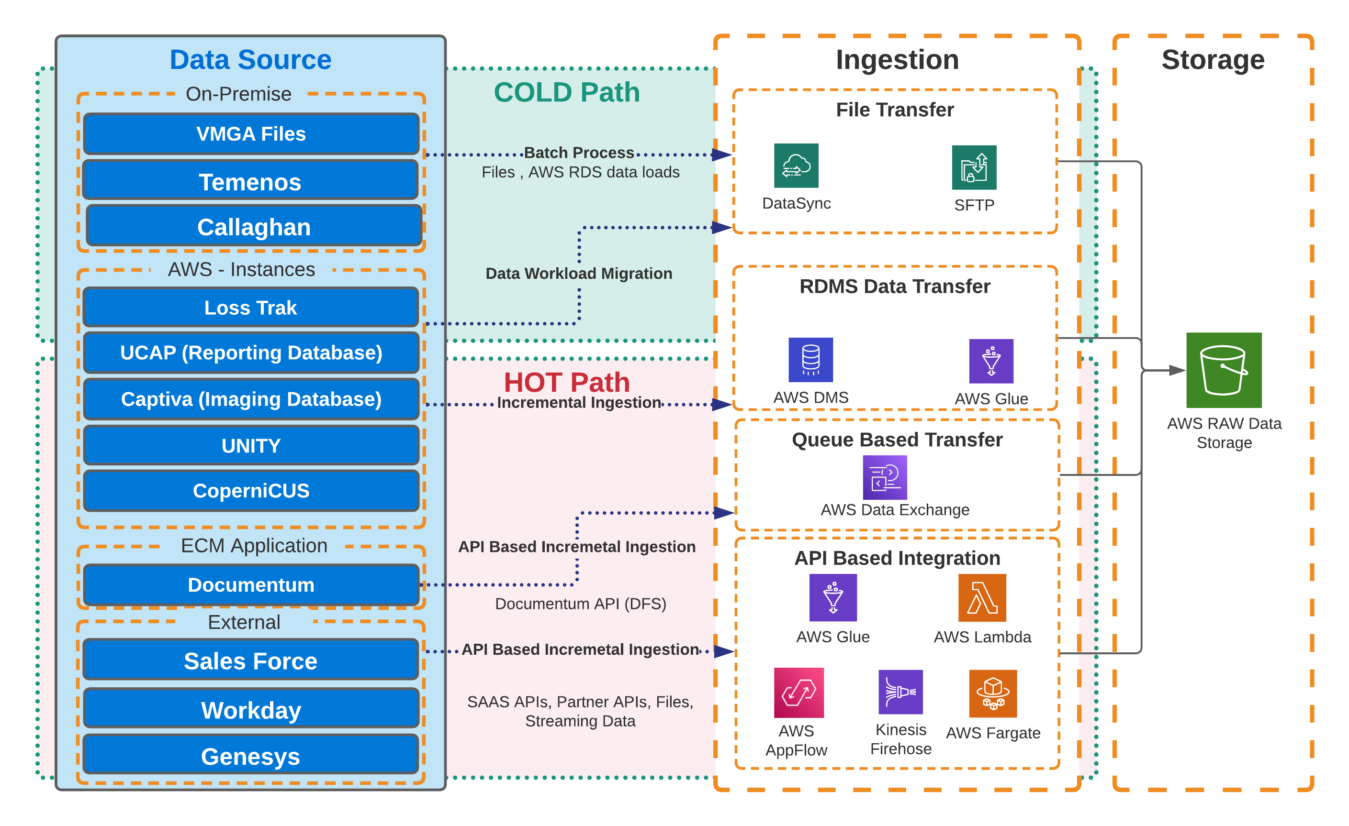
Data Ingestion – Design Flow

Slide 20
Data Storage – Design Flow
RAW
Immutable store that can’t/shouldn’t changed after it has been written. The data can be in different file types.
Tech Standardized
Casting is performed on the data to keep it as close to Source data structure and the file is standardized to a format like Parquet, optimized row column (ORC). Metadata about the files are cataloged in Glue Data Catalog to enable analysis of the data.
Optimized
To gain speed and normalized data, data transformation process executed to optimize data before storing. Optimized formats like Parquet, optimized row column (ORC) can be used. Business validations can be performed in this layer
Conformed & Curated
Contains EDW and Data Marts for Enterprise and LOB specific BI reporting and Data warehousing, reference functions.
RAW
Tech Standardized
Optimized
Conformed
& Curated
Unmodified from Source
Optimized for analysis on Raw data (Partitions)
Optimized for analytics (Partitions)
EDW and Data Marts
Time based move to archive storage
Data Types are similar to data in Source
Denormalized / Flattened / Enriched
Ready for Business Analytics and Reporting

Slide 21
Data Storage – File Formats
File Formats | Properties
ORC | Columnar, schema stored in footer
Parquet | Columnar, schema stored in footer
Avro | Row-major, schema and data separate
CSV | Human readable, fixed schema
Json | Human readable, fixed schema

Slide 22
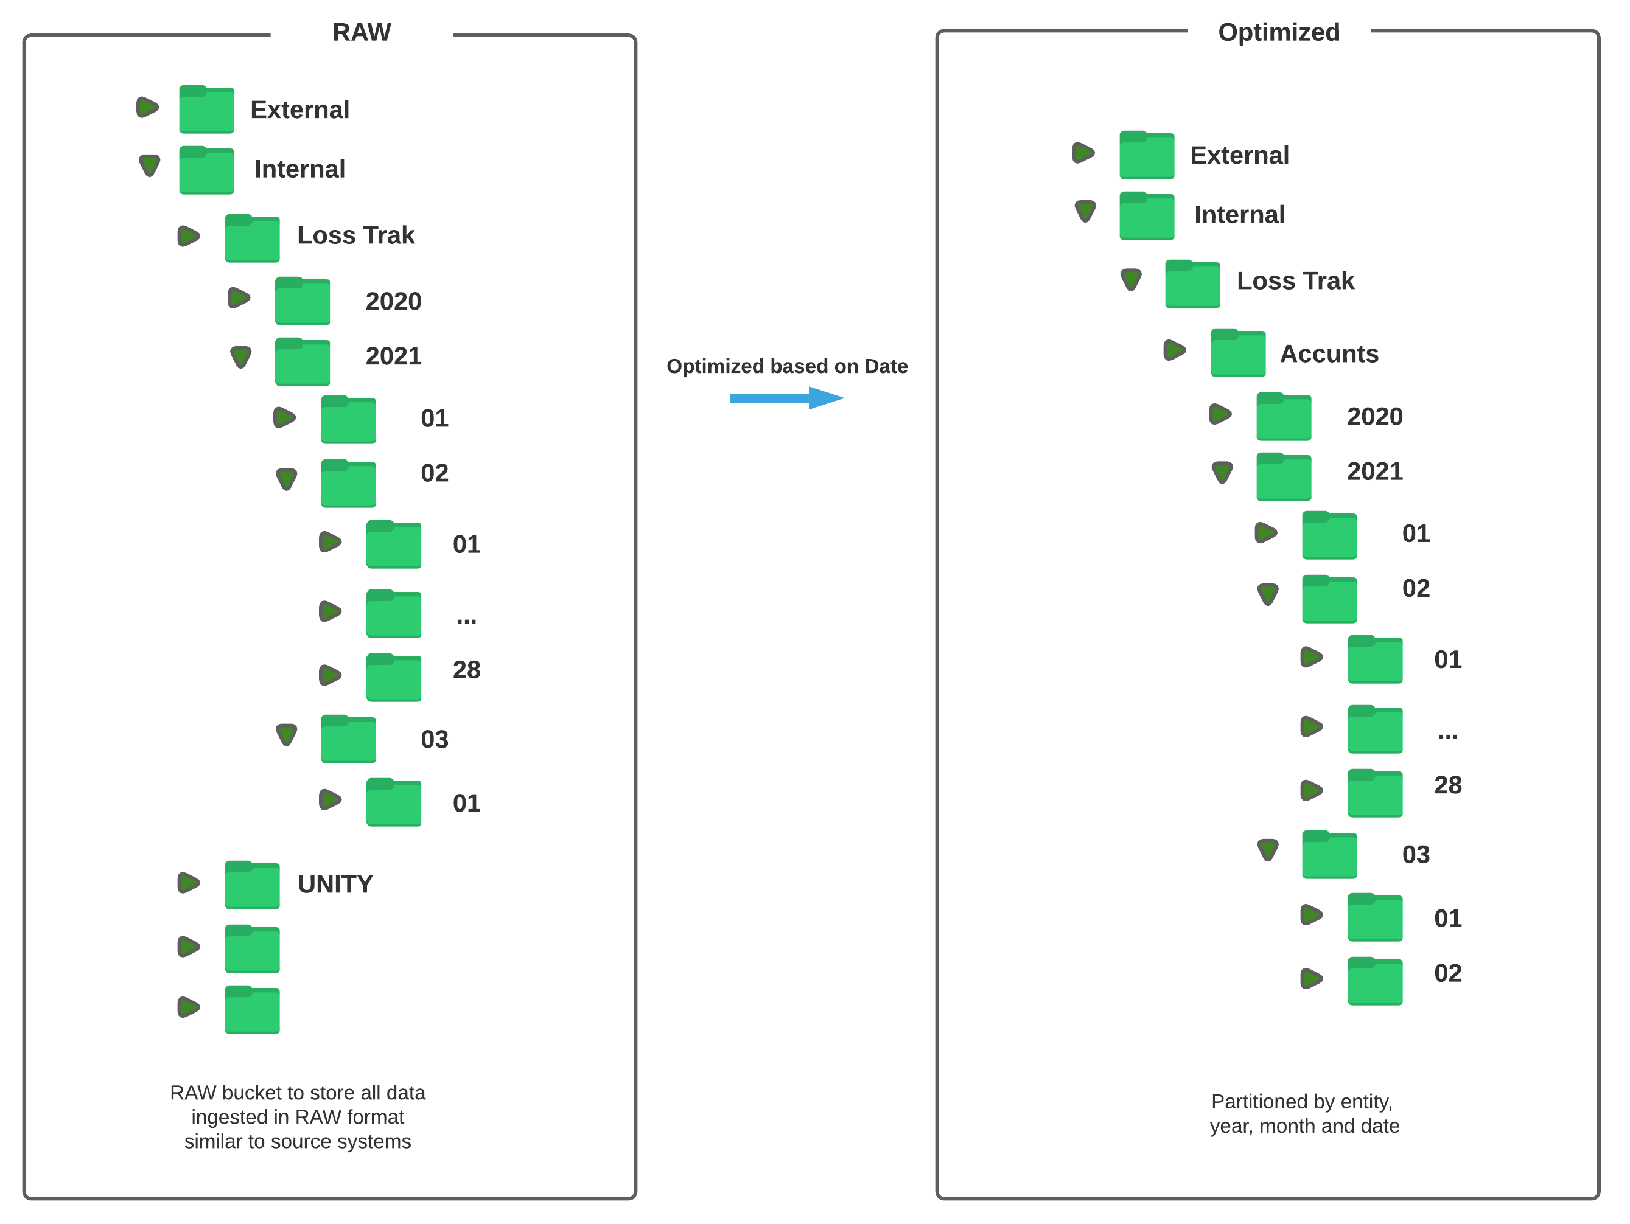
Data Storage – Partitions

Slide 23
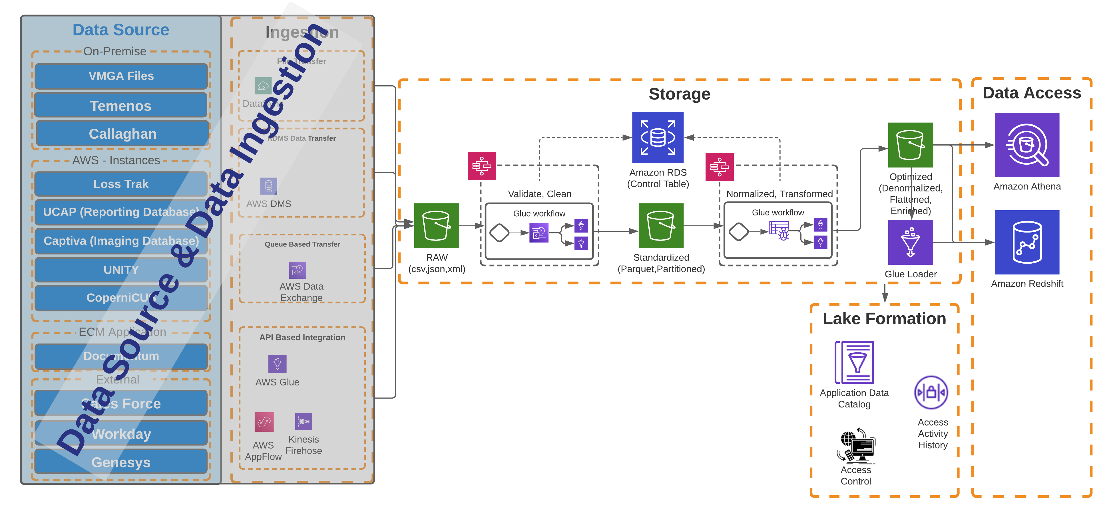
Data Storage – Design Flow

Slide 24
Data Governance – Framework
Vision &
Mission
Vision & Mission
Strategy & Roadmap
DG Charter
Principles & Policies
Data Governance Principles
Enterprise Data Governance Policy
Enterprise Data Quality Policy
Definitions & Standards
DG Definitions & Glossary
Metadata Standards
Data Quality Standards
Data Architecture Standards
Organization Structure
Data Governance Program Office
Data Ownership & Stewardship Role Definitions
Processes & Procedures
Data Governance Process
Data Profiling & Quality Analysis*
Issue Management & Escalation
Review and Audit
* Vital to determine health of data
Tools & Techniques
Data Modeling
Metadata Repository
Data Quality/ Profiling
Workflows & Reporting
Measures & Reports
Data Quality Scorecards
Policy and Standards Adherence Reports

Slide 25
Data Governance – A Critical First Step
Foundational Components of DG
Transformational Components of DG
Data Office
Define Data Strategy
Manage Risk & Compliance
Actionable Insight Into Data Estate
Democratize Data For Decision
Data Quality
Data Lineage
Metadata
Data Catalogue
Data Privacy
Data Governance
Trust in data
Trace data origin
Ubiquitous rollout of Data Governance
Data driven decision culture
Central Data Platform
Single source of Truth
Promote Self Service Culture
Foster innovation through data
Ladder for Enterprise maturity
Business Objectives
Informed Decision Making
Regulatory Compliance
Availability
Measurability
Accountability
Profitability
Security

Slide 26
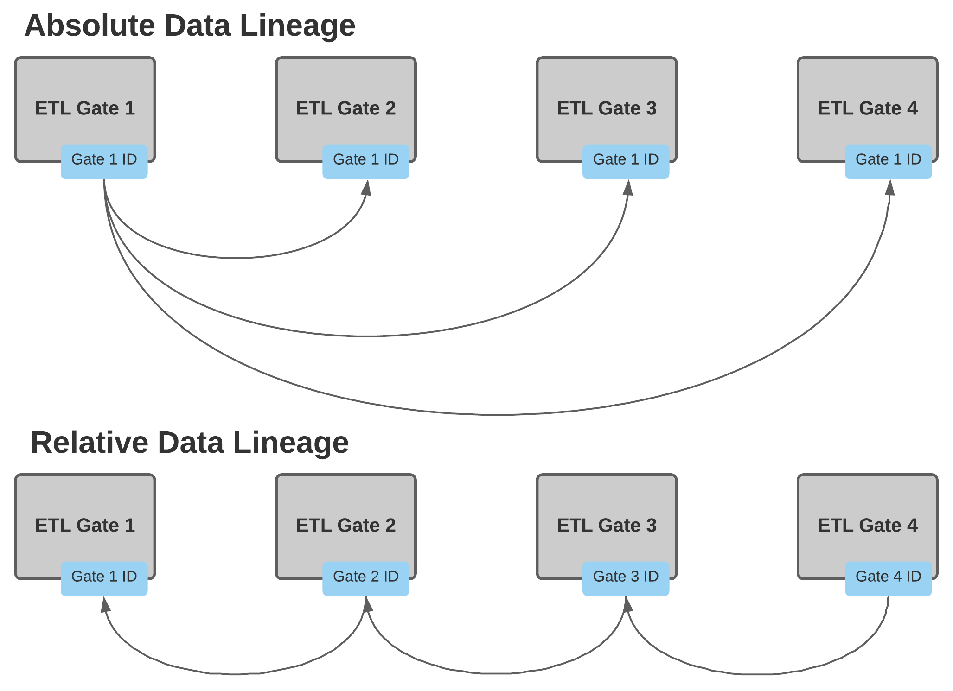
Data Lineage – Patterns
Absolute Data Lineage
Relative Data Lineage
Using data Origin Key
With Point back reference Key / Keys
Absolute Data Lineage
Data tracking each row all the way back to its Origin using the first available key value. Relatively complex process with source dependencies.
Relative Data Lineage
ETL process with multiple steps, set up each table so that every row will have a pointer back to the key from the table that immediately preceded that load process. More applicable for enterprise data architecture with multi-step ETL process.
Track back to origin using source key
Based on reference integrity.

Slide 27
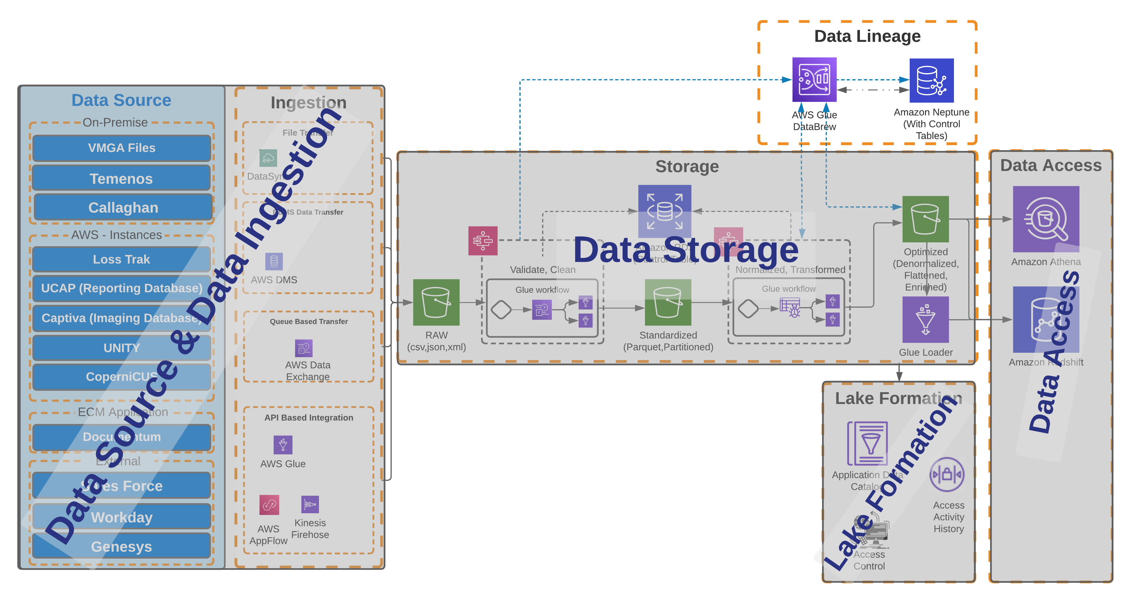
Data Lineage – Design Flow

Slide 28
Data Security
Monitor
Detect
Respond
Monitor
Identifying data inconsistencies and using the right checks and KPIs is often a challenging task, especially in commonly used heterogenous system landscapes.
Detect
Integrating effective data quality processes and tools often very complex. The importance is even increasing in the context of harmonization which drive even higher requirements and complexity for data quality and cleansing.
Respond
Development of a plan that defines roles, responsibilities, sequencing, funding and technology enablers to perform all other data quality management related activities.
AWS Services / Systems
Events and Alarms
Remediation Action
Compensating Control
Hosted Applications
Incoming Notifications
Outgoing Notifications

Slide 29
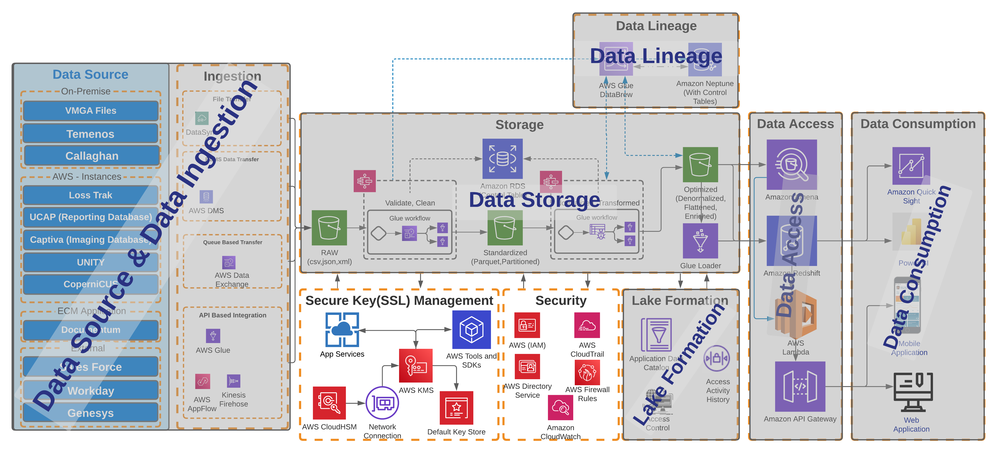
Data Security – Design Flow

Slide 30
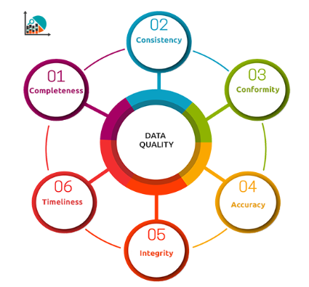
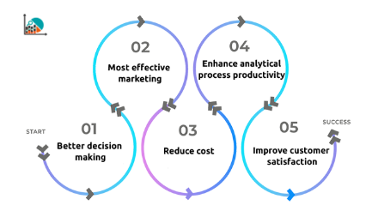
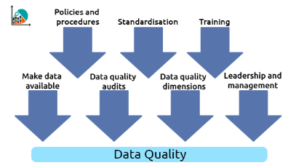
Data Quality Management
59%
- FI’s mentioned DQM as the top Strategic Initiative for 2021 in a recent survey by Profisee Inc.
Why it Matters
Purpose
Critical Elements
Global Insurer
Enterprise DQ Management
DQ framework and principles at enterprise level
Objective – DQ as a Shared Service construct
Program, BU & Corporate Scorecards
Global Life Insurer
Data Quality Improvement’ initiative
Multi year program covering people, process & tools
Empowered Data Stewards Orgn.
Leverage AI /ML based techniques
30

Slide 31
Data Quality Management – 3 Major Pillars
Audit
Balance
Control
Audit
Identifying data inconsistencies and using the right checks and KPIs is often a challenging task, especially in commonly used heterogenous system landscapes.
Balance
Integrating effective data quality processes and tools often very complex. The importance is even increasing in the context of harmonization which drive even higher requirements and complexity for data quality and cleansing.
Control
Development of a plan that defines roles, responsibilities, sequencing, funding and technology enablers to perform all other data quality management related activities.
Identify Data Standards
Improve business and technical processes
Timing and communication
Analyze Business Impacts
Develop Data Quality Audits
Responsible parties

Slide 32
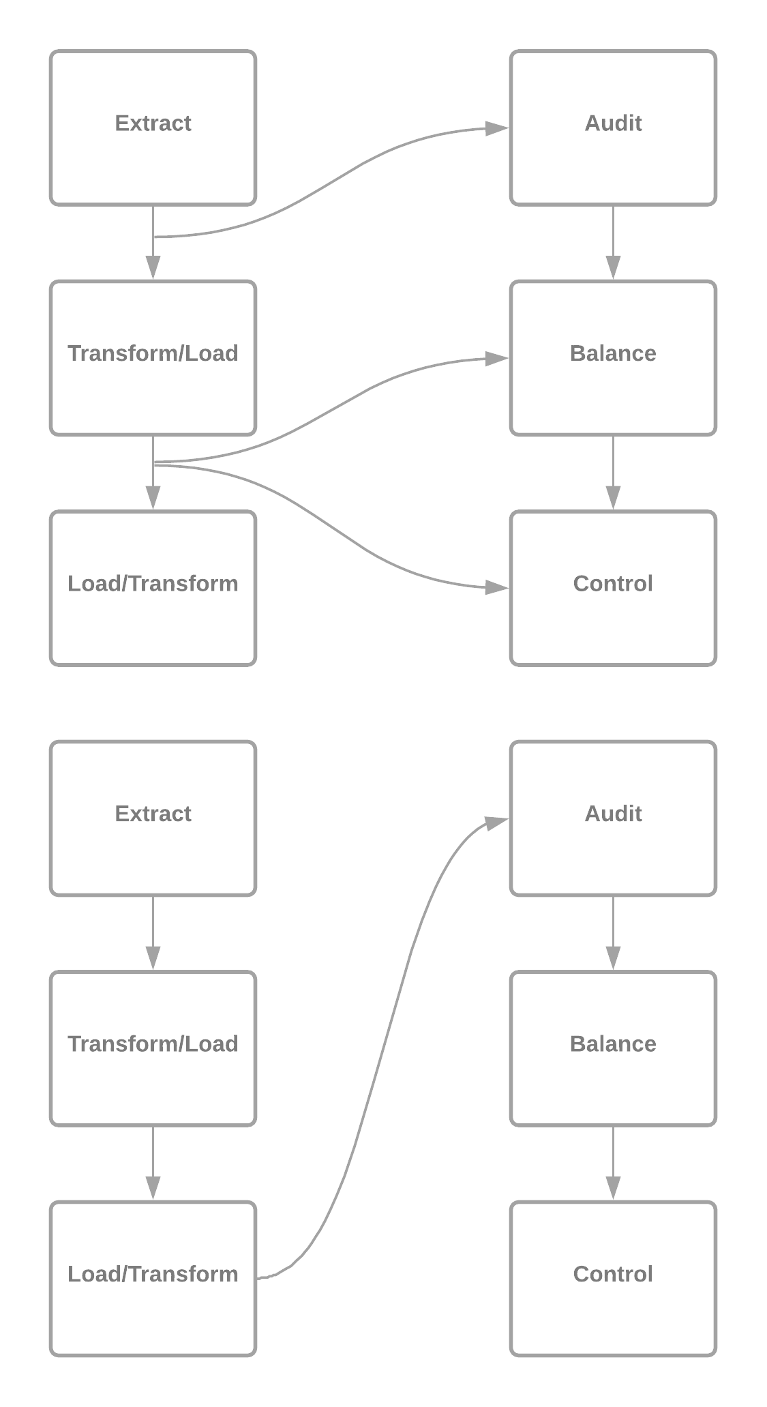
Orchestration of DQM Tasks with Events
Serial Orchestration
Sequential Orchestration

Slide 33
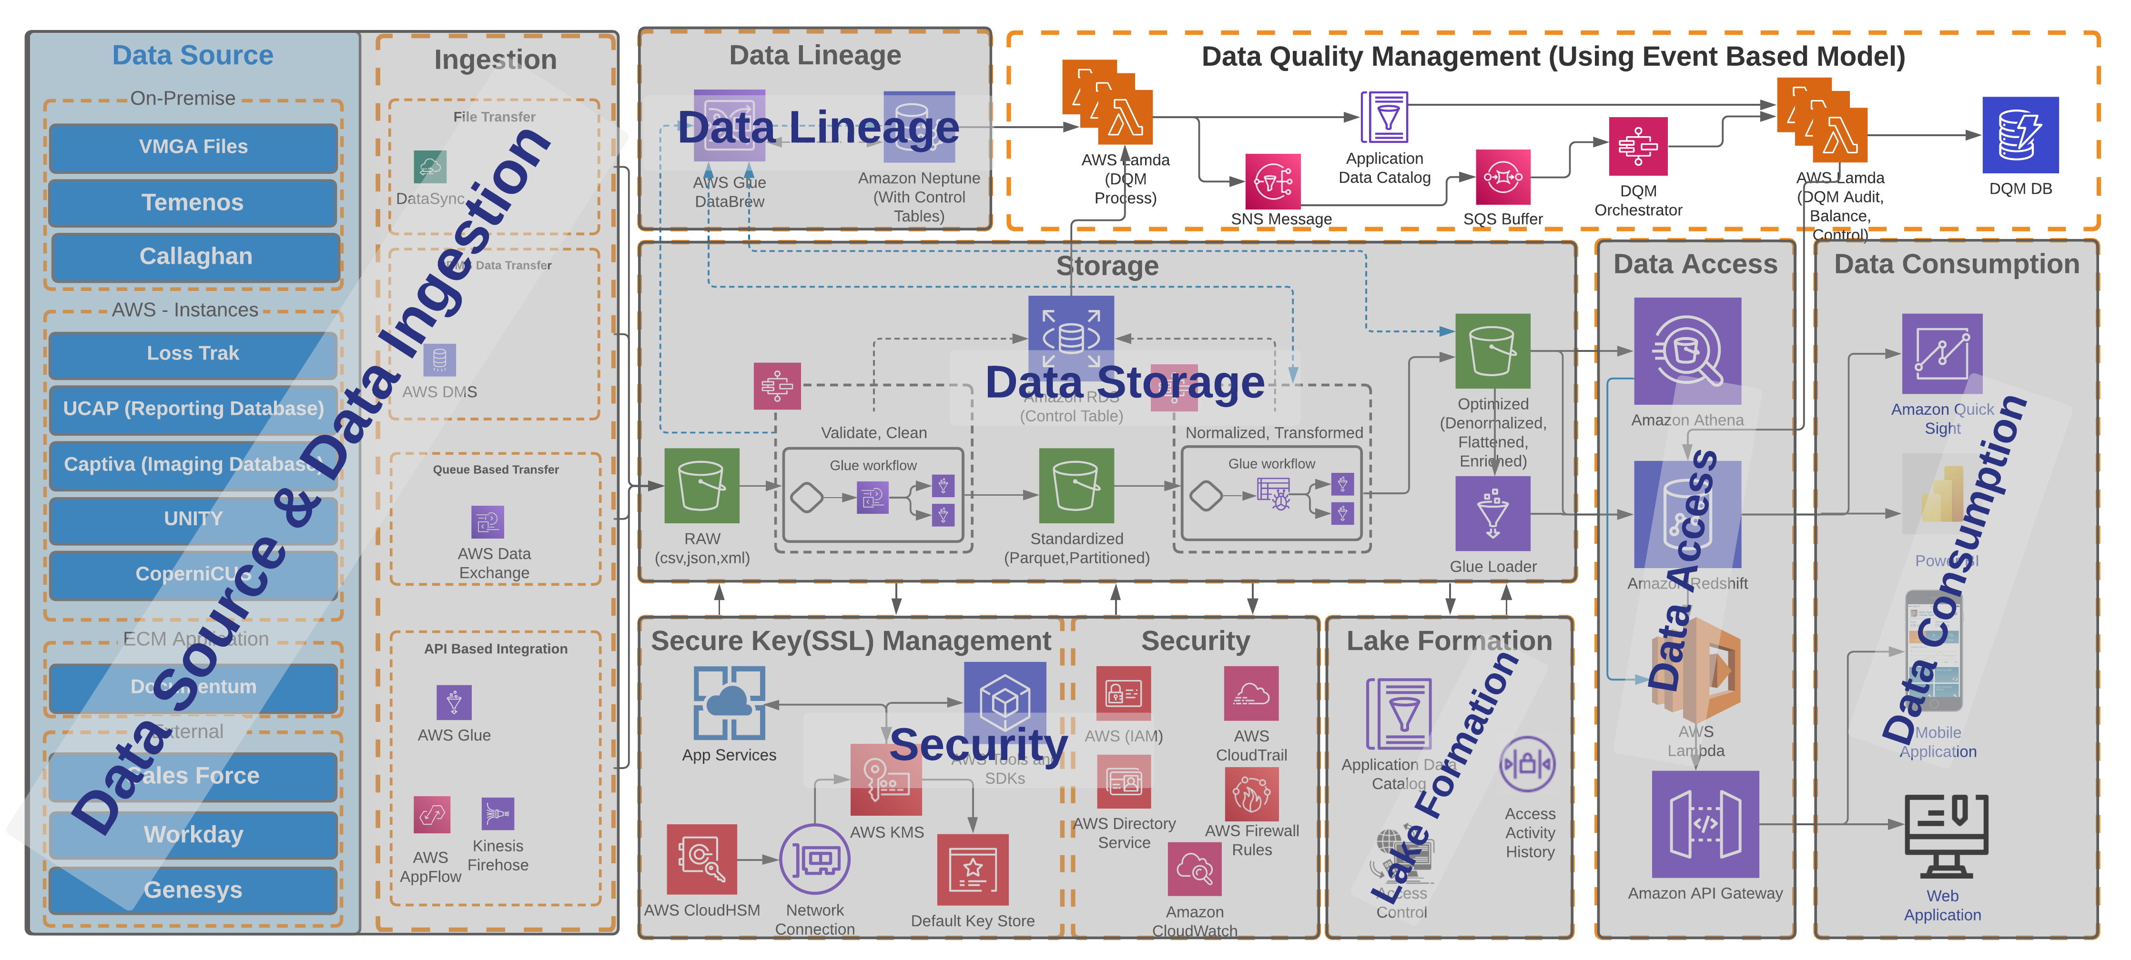
Data Quality Management – Design Flow

Slide 34
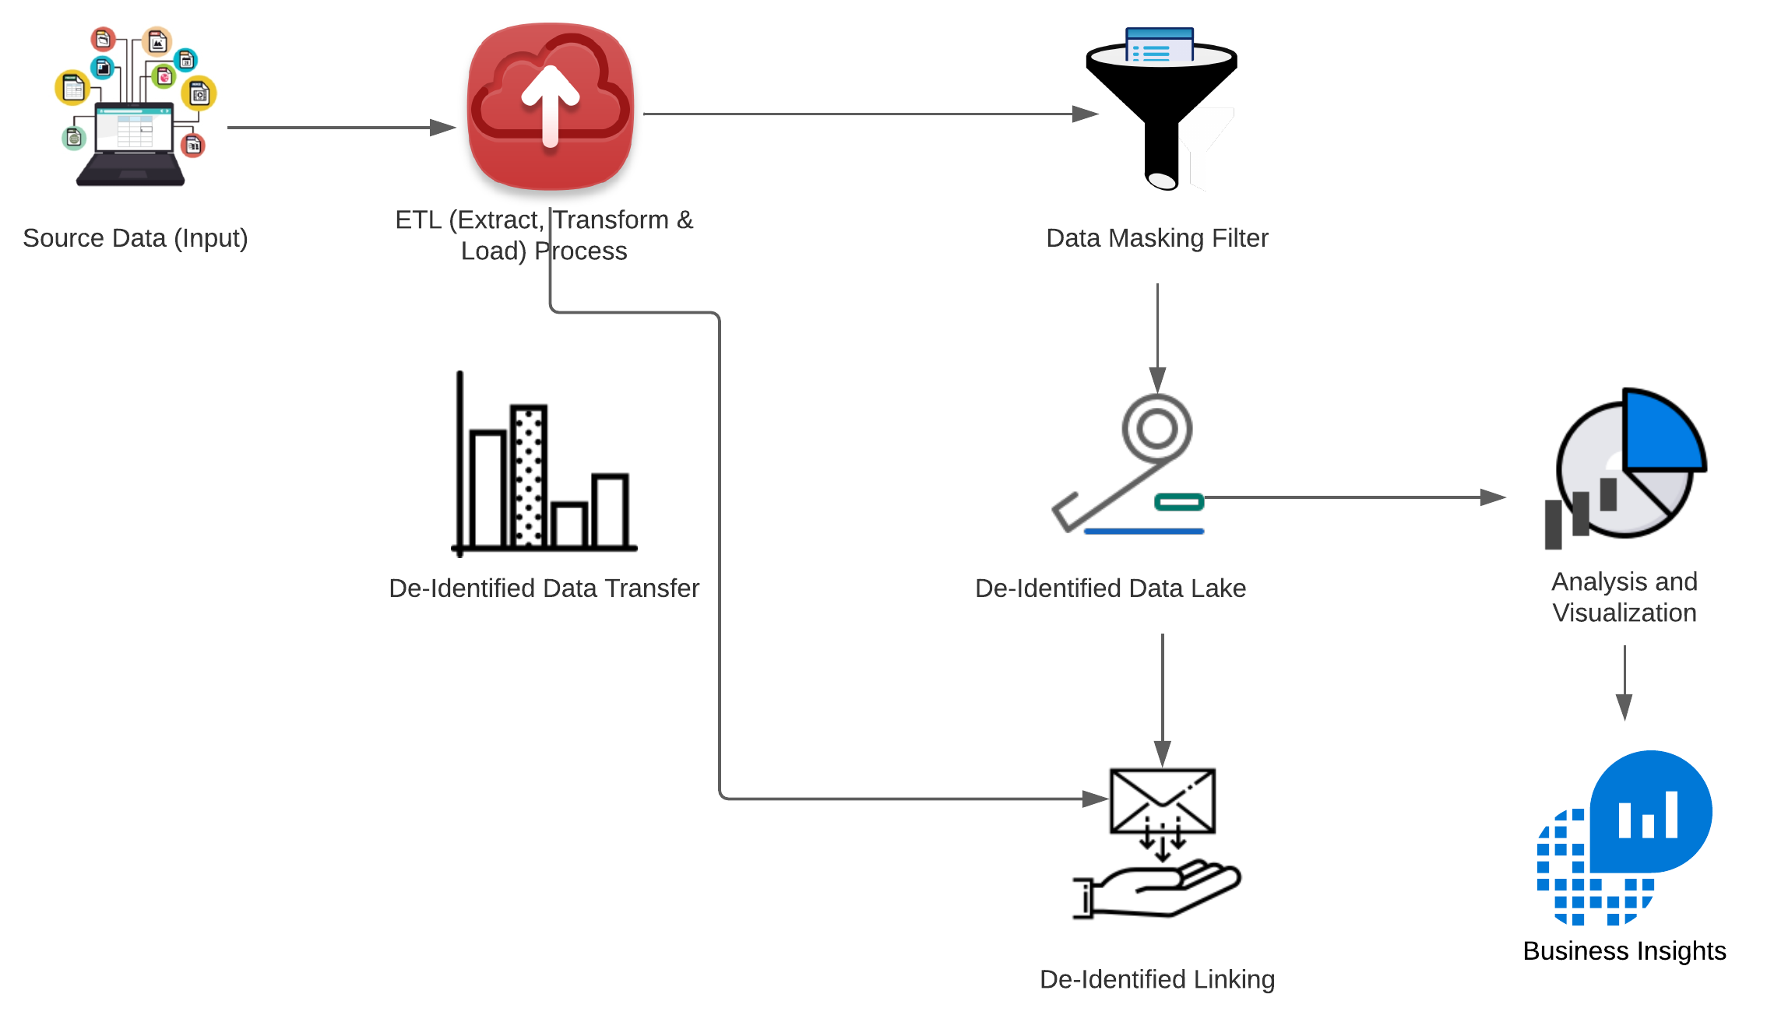
PII Data Management
PII Data Management – Using De-Identified Process
Enterprise Data Management system stores lot of privacy data which is rarely used for generating insights. If we remove privacy data and replace it with random tokens during ingestion, we can eliminate risks related to security breach in data lake.
The solution even supports the data exchange with third parties. The solution has following components
Data Transformation stage
Data Catalog
De-Identification Engine
Data Linking Engine
De-Identified Process - Overview
De-Identification right at the time of ingestion
Replaces PII, HIPPA and other categories of private data with tokens
Supports Structured, Unstructured & Streaming data
Supports secure data exchange with third parties
Tokenization
Hitching
Fully configurable rules engine to select the data for De-Identification

Slide 35
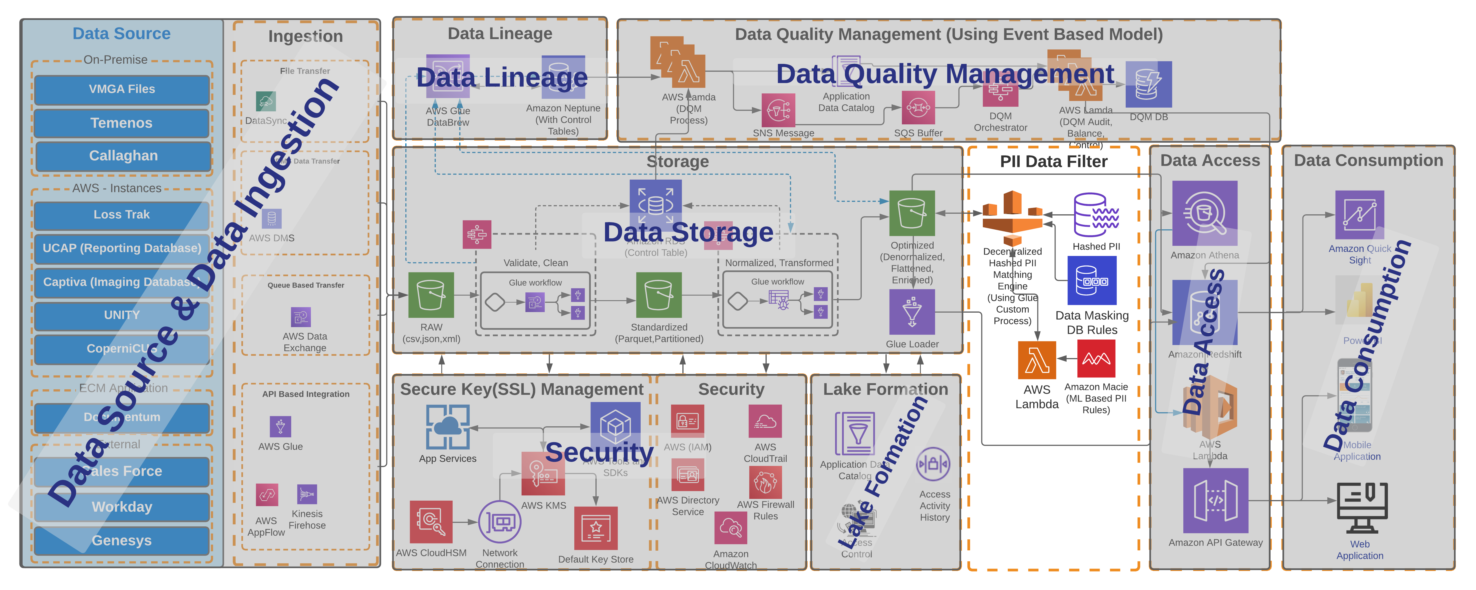
PII Data Management – Design Flow

Slide 36
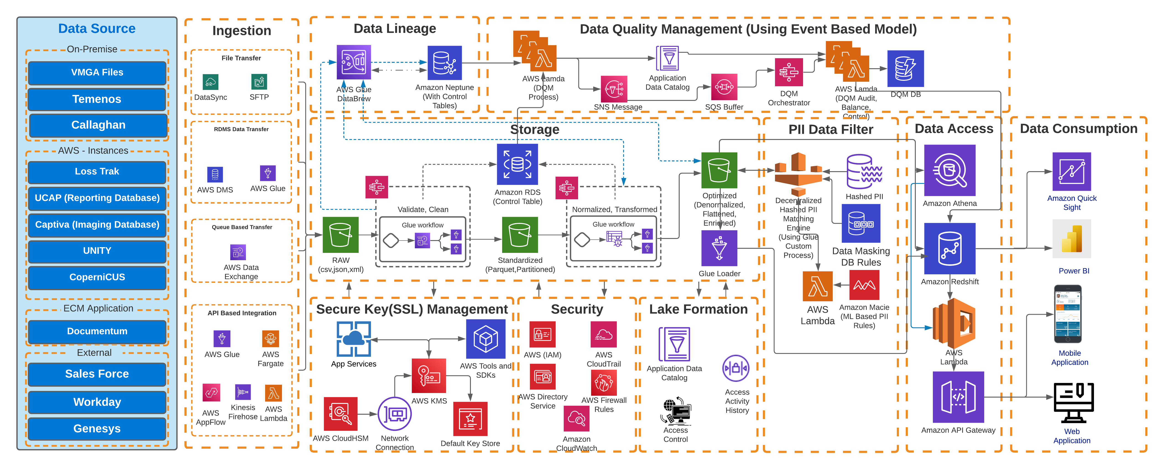
Target State Architecture

